Slide 1

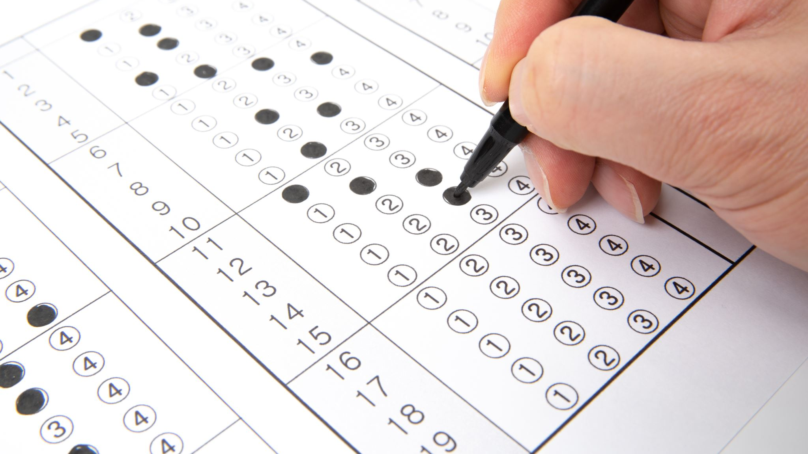
Text Mining and Natural Language Processing

Slide 2
About NLP
What is NLP?
NLP is a branch of Data Science & AI
It helps computers understand human language
Works with text and speech data
NLP teaches computers how to read and understand human language
Example:
“I Like Python.”
→ Computer converts this into numbers.

Slide 3
Why is NLP needed in Data Science?
Why NLP?
Most real-world data is unstructured text.
Computers only understand numbers.
NLP converts text → machine-readable format.
Importance
Enables machine learning on text data.
Improves accuracy of models.

Slide 4
Real-World Application of NLP
NLP is used in:
Google Search
Chatbots (Customer Support)
Email Spam Detection
Sentiment Analysis (Review)
For NLP we use NLTK.
NLTK ➔ Natural Language Toolkit, a python library for NLP tasks
NOTE: Never use nltk.download(‘all’). Only download required package.

Slide 5
Required basic packages
Import nltk
nltk.download('punkt’) → Tokenization
nltk.download('stopwords’) → Removing common words
nltk.download('wordnet’) → Lemmatization
nltk.download('omw-1.4’) → Word meaning support
nltk.download('averaged_perceptron_tagger’) → POS Tagging

Slide 6
What is Text Preprocessing?
Text Preprocessing
Cleaning and preparing raw text
Makes text suitable for ML models.
Why is it needed?
Raw text is noisy.
Noise reduces model accuracy.

Slide 7
Steps in Text Preprocessing?
Common Steps
Lowercasing
Removing Punctuation
Removing numbers
Removing stop words
Stemming / Lemmatization

Slide 8
Text Cleaning & Regular Expressions (Regex)
What is Text Cleaning?
Removing unwanted symbols and characters
What is Regex?
Pattern-matching technique
Used to find or replace text
Regex is used to:
Remove special characters
Extract emails & numbers
Clean social media data
Real-World Use
Twitter data cleaning
Chatbot message processing

Slide 9
Regex – Common Codes
Pattern | Meaning
\d | Digit
\w | Word Character
\s | Whitespace
+ | One or more
* | Zero or more
Helps to control text extraction and cleaning

Slide 10
Stop Word Removal
What are Stop Words?
Common words with little meaning.
Examples: is, am, the, in
Why remove them?
Reduce noise
Improve model performance
Example:
Python is very easy to learn
[‘Python’, ‘easy’, ‘learn’]
Reduces feature size.

Slide 11
Stemming and Lemmatization
What is Stemming?
Reduces words to root form.
Root may not be meaningful
Examples:
Playing → Play
Studies → Studi
Usage
Search Engines
Spam Detection
What is Lemmatization?
Converts word to meaningful base form.
More accurate than stemming
Examples:
Running → Run
Better → Good
Usage
Preserves meaning

Slide 12
POS Tagging (Part of Speech)
What is POS Tagging?
Identifies grammatical role of words.
Examples
NN → Noun
VB → Verb
JJ → Adjective
Example
Python is easy to learn.
Python → Noun
Is → Verb
Easy → Adjective
Learn → Verb

